Slide 1

INE401- Production Planning and Control
Zeynep Ayça Polat - 20201704080
Salih Aladdin Sarıhan - 20191704006
Aynur Berin Tüccar - 20201704076
Efe Berke Akkaya - 20201704069
Elif Nihan Koç - 20191704019

Slide 2
AGENDA
COMPANY PROFILE
History of the Company
What are Dental Implant Systems?
Manufacturing Processes
Quality Policy
DEMAND FORECASTING
INVENTORY MANAGEMENT
PRODUCTION PROCESS CHART
TIME STUDY OF THE PRODUCTS IN QUALITY CONTROL
DISCUSSION
CONCLUSION

Slide 3

COMPANY PROFILE
Founded in 2007 in Istanbul by Görkem Serçe, and Ahmet Altuğ Serçe
Limited Company with two partners
Started as an importer, expanded into manufacturing in 2010
The facility in Trabzon Beşikdüzü
Specializes in dental implants; introduced Implance brand in 2011
Became distributor of Implantswiss; FDA approval in 2017
Entered the US market, became a global leader
Production facility expanded, diverse product range

Slide 4
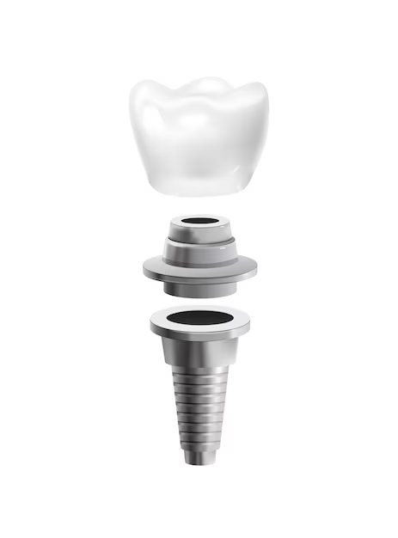
DENTAL IMPLANT SYSTEMS?
Purpose of Dental Implants
Effective solution for tooth loss challenges
Long-lasting prosthesis with biologically suitable materials
Aims for cosmetically and functionally similar teeth.
Material Advancements
Durable ceramics and polymer-based materials
Long-lasting, aesthetic look close to natural teeth

Slide 5

DENTAL IMPLANT SYSTEMS?
Precision Fit and Aesthetic Design
Digital technologies enhance prosthetic fit
Facilitates achieving a more natural appearance
Color-matching and custom design options are available
Digital Technology and 3D Printing
Precise oral structure examination through digital scanning
3D printing accelerates production of custom-designed prosthetics

Slide 6

DENTAL IMPLANT SYSTEMS?
Implant-Supported Prostheses
Titanium screw-like structures integrated into jawbone
More robust and natural solution than traditional prosthetics
Simultaneously restores chewing function more effectively

Slide 7

DENTAL IMPLANT SYSTEMS MANUFACTURING PROCESSES?
Material Selection and Manufacturing
Packaging and Delivery
Design Phase
Surface Processing
Sterilization

Slide 8
DENTAL IMPLANT SYSTEMS MANUFACTURING PROCESSES?
Material Selection and Manufacturing
Machines Used in Production
Machine
ViciVision MTL X5
QuickVision
Mitutoyo PH-14
Mitutoyo Measuring Microscope
Function
Measure external dimensions of products
Measure inside of cylindrical products and openings
Measure product's shadow by reflection
Precision measurement machine

Slide 9

DENTAL IMPLANT SYSTEMS MANUFACTURING PROCESSES?
Material Selection and Manufacturing
Basic Process Workflow
1
2
3
4
5
Surface Examination
Discarding Faulty Products
Handover for Measurement
Product Arrival
Technician's Action
6
7
Measurement Using ViciVision or QuickVision (Depending on the Product)
Documentation and Completion

Slide 10
PRODUCT CATEGORIES IN DENTAL IMPLANT SYSTEMS
Dental Implants:
Titanium screws replace real tooth roots
Abutment:
Connector placed on dental implant to support prosthetics
Prosthetics:
Crowns, bridges, or dentures connected to dental implants
Surgical Kit:
Set of surgical instruments for implant placement

Slide 11
PRODUCT CATEGORIES IN DENTAL IMPLANT SYSTEMS
Impression Materials:
Create precise molds for custom prosthetics production
Bone Graft Materials:
Strengthen jawbone in cases of insufficiency
Membranes:
Improve bone regeneration and implant integration

Slide 12

QUALITY POLICY
ISO 13485:2016 Certification and Quality Management:
Demonstrates strong emphasis on quality standards
Precision in Dental Implant Production:
Inspection of materials, including titanium, for precision
Utilization of advanced equipment like ViciVision MTL X5 and QuickVision
Global Commitment to Quality:
Serves Turkish and international markets
Rapid growth evident in increased monthly production

Slide 13
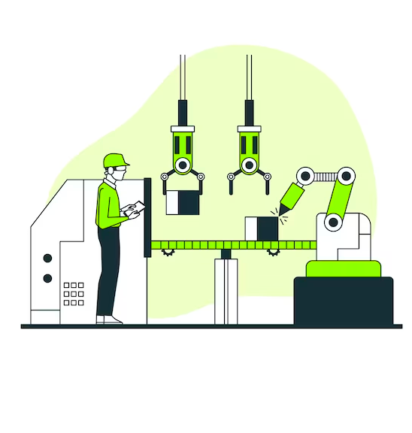
QUALITY POLICY
Proactive Measures for Machinery Maintenance:
Ensures optimal conditions for equipment functionality
Extended Quality Control in Production Stages:
Detailed product inspection with minimum error rate
"First Production and Quality Control Department" significance
Harmonious Mass Production:
Initial inspection vital for accurate mass production
Slogan: "Finding Quality Near You at an Affordable Price":
Reflects commitment to accessible healthcare excellence

Slide 14
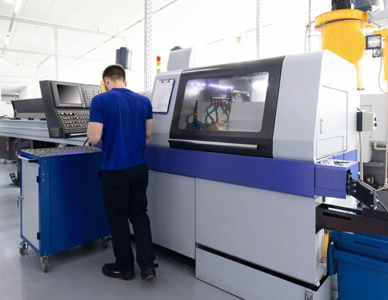
QUALITY POLICY
Quality Control in the CNC Department:
Random hourly checks on products by technicians
Rigorous checks for compliance, defects, and measurements.

Slide 15

DEMAND FORECASTING
Overview of Forecasting
Definition: Predicting future events based on data.
Importance: Guides business decisions and planning.
Time Horizons:
Short-range (up to 1 year)
Medium-range (3 months to 3 years)
Long-range (3 years and beyond)

Slide 16

DEMAND FORECASTING
Types and Approaches in Forecasting
Qualitative vs. Quantitative Methods
Qualitative for unclear situations and limited data.
Quantitative for stable situations and historical data.
Quantitative Approaches:
Time Series Models
Associative Models
Application Examples:
Short-range: Purchasing, job scheduling, workforce.
Medium-range: Sales, production planning, budgeting.
Long-range: New product planning, facility location.

Slide 17
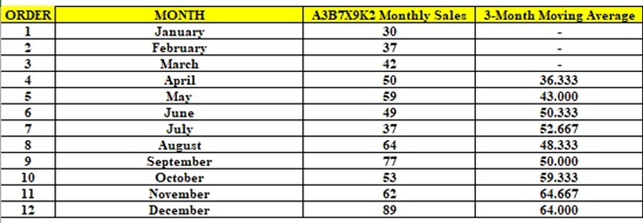
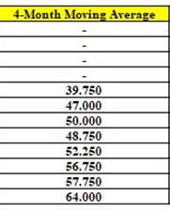
Forecasting methods that have been used (showed with the product coded A3B7X9K2 regarding the demand forecasting) :
Moving Average (3 and 4 months)

Slide 18
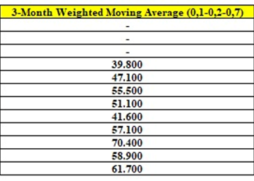
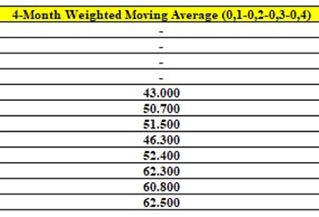
·Weighted Moving Average (3 months with weights 0.1, 0.2, 0.7 and 4 months with weights 0.1, 0.2, 0.3, 0,4)

Slide 19
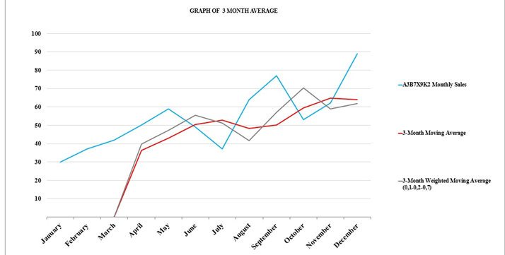
·Weighted Moving Average (3 months with weights 0.1, 0.2, 0.7 and 4 months with weights 0.1, 0.2, 0.3, 0,4)

Slide 20
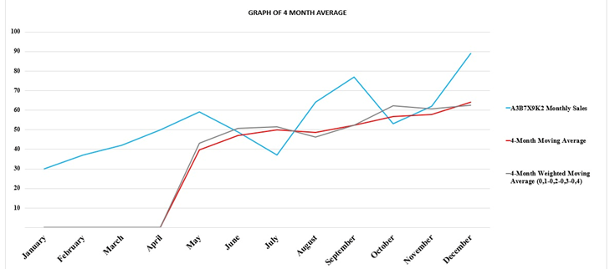
·Weighted Moving Average (3 months with weights 0.1, 0.2, 0.7 and 4 months with weights 0.1, 0.2, 0.3, 0,4)

Slide 21
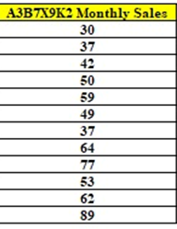
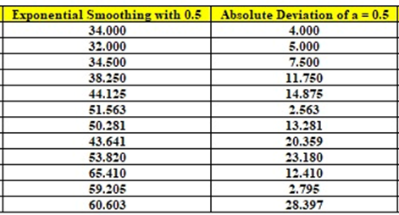
·Exponential Smoothing with =0.2 and α=0.5

Slide 22

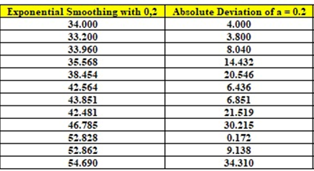
·Exponential Smoothing with =0.2 and α=0.5

Slide 23
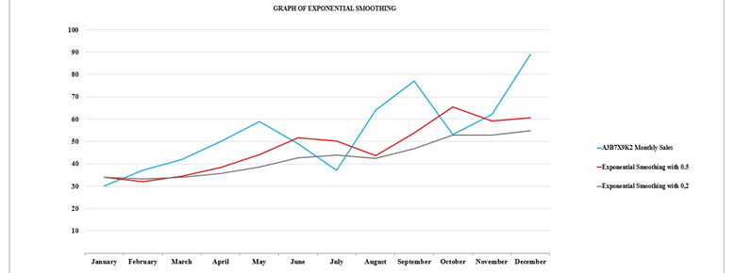
The graph to show the difference between a = 0.5 and a = 0.2

Slide 24
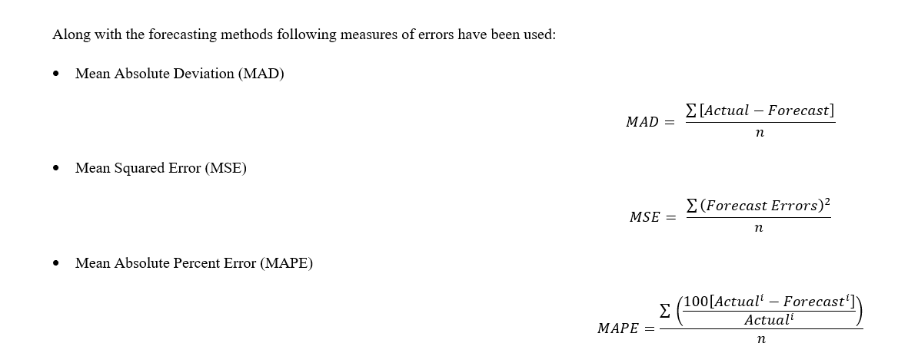
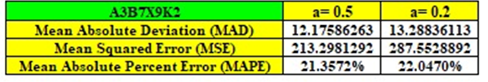
Measures of errors have been used

Slide 25
Seasonal Index (3 products)
Definition:
Measures seasonal variation and changing demand trends.
Significance:
Separates seasonal fluctuations for accurate trend analysis.
Eases tracking of genuine economic trends.
Calculation Method: Percentage of Mean
Express monthly data as percentages.
Calculate mean or median of monthly percentages.
Adjustment Process:
If mean ≠ 100%, adjust by multiplying indices.
Obtain seasonal index for each month.

Slide 26
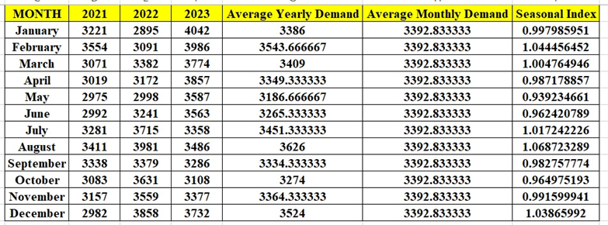
Here are three examples to show the products’ seasonal index. In the tables below, data related to 2021

Slide 27
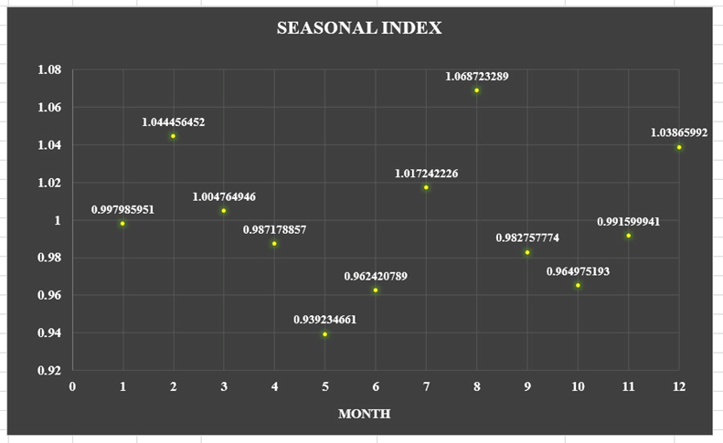
To see the data visualized in a clear way, scatter plots are used

Slide 28

INVENTORY MANAGEMENT
ABC ANALYSIS OVERVIEW
Classifies inventory into A, B, and C
Based on the importance and impact on costs
A crucial for control and precise records
The method identifies items requiring separate management

Slide 29

INVENTORY MANAGEMENT
STEPS IN ABC ANALYSIS
Calculate the annual consumption value for each item
Sort items in decreasing order of importance
Compute cumulative yearly consumption value and percentage
Sort items into A, B, and C categories
Divide the total annual consumption value by mean
Calculate the percentage of the mean for each item
Compute the mean or median for each group
Adjust indices for equalization if necessary
The seasonal index is a product of the mean percentage

Slide 30
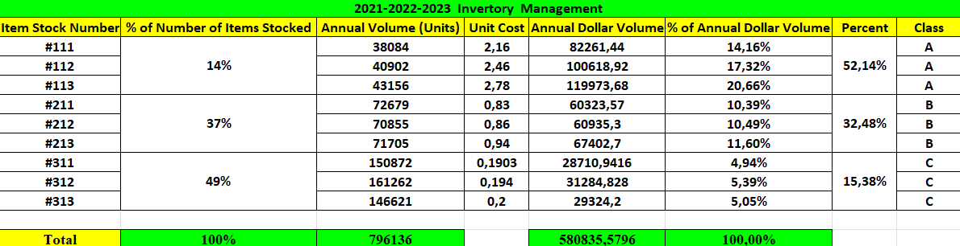
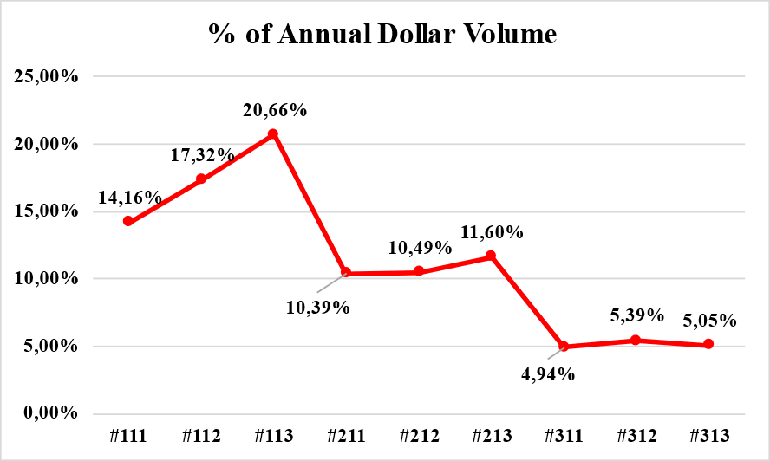
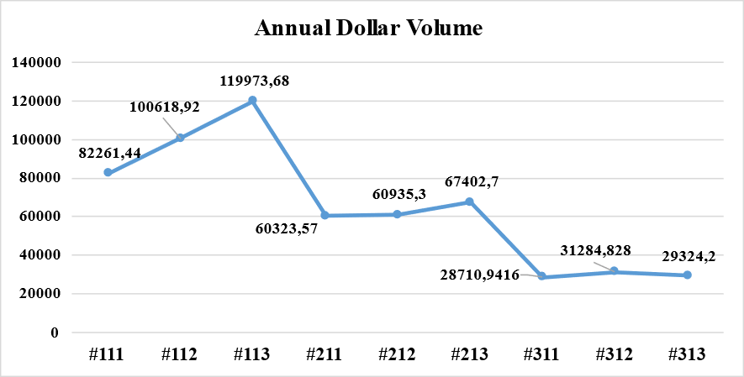

Slide 31
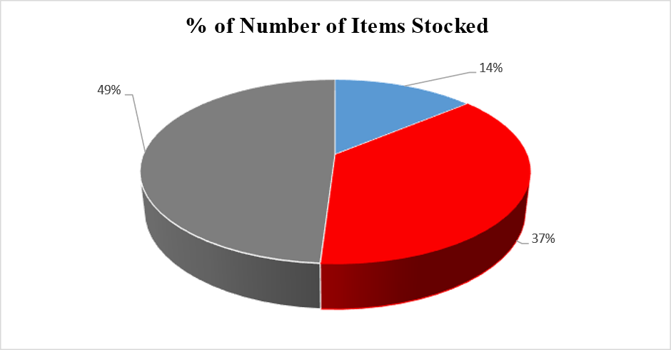
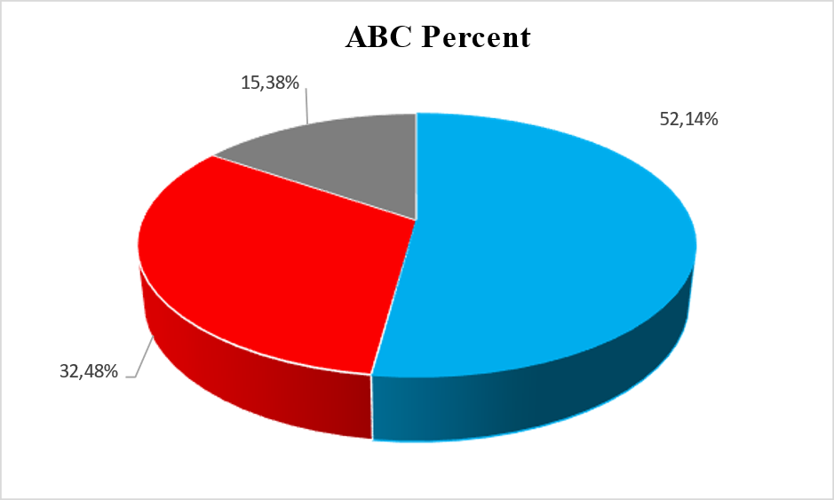
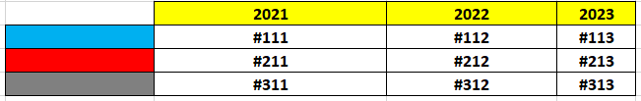

Slide 32
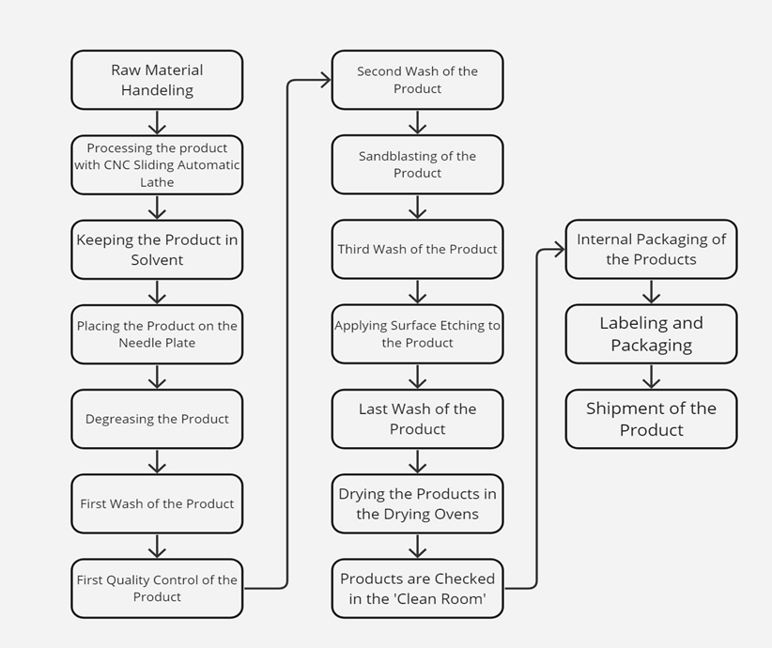
PRODUCTION PROCESS CHART

Slide 33
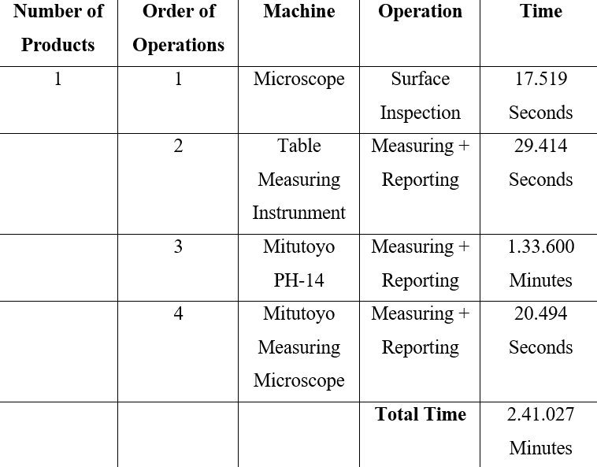
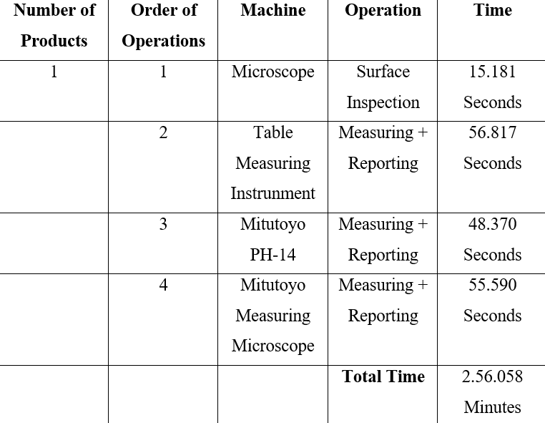
TIME STUDY OF THE PRODUCTS IN QUALITY CONTROL

Slide 34
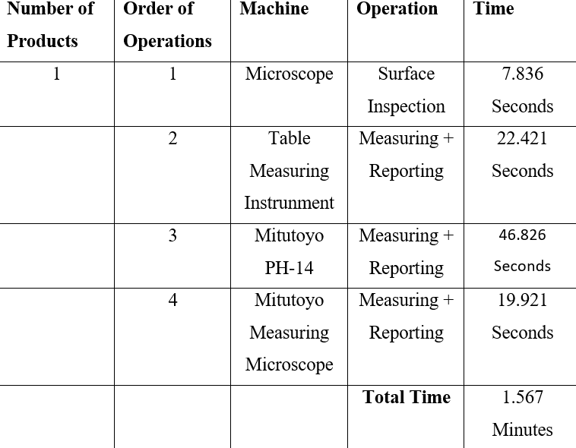
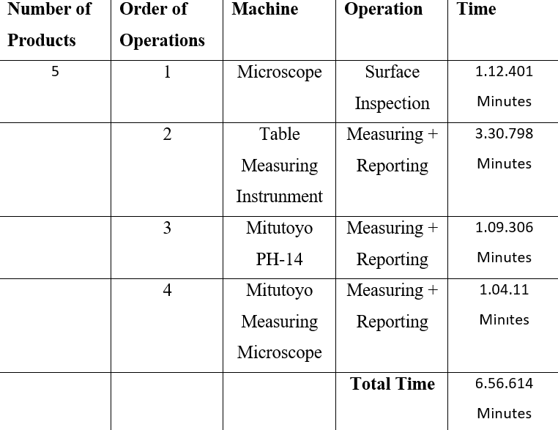

Slide 35


DISCUSSION
A dataset from a company provides real-life experience
Opportunity to find alternative ways for improvement
Mathematical models crucial for checking forecast usability
Generating random data tests forecasting robustness
Larger datasets are preferred to avoid misleading results (overfitting risk)
No significant difference in forecasting results observed
Multiple products and methods enhance reliability

Slide 36
CONCLUSION
Project Overview
Demand forecasting using AGS Medikal's real-life dataset
Different methods and time periods explored
6 products for forecasting, 3 for ABC analysis
Focus on finding optimal forecasting for future demand
Error Measurement and Optimization
Mean Absolute Deviation (MAD) showed the smallest errors
Mean Squared Error (MSE) indicated greater results
The selection of the optimal mathematical approach crucial
Multiple methods, periods, and coefficients tested
Aim to identify optimum forecasting for the company

Slide 37
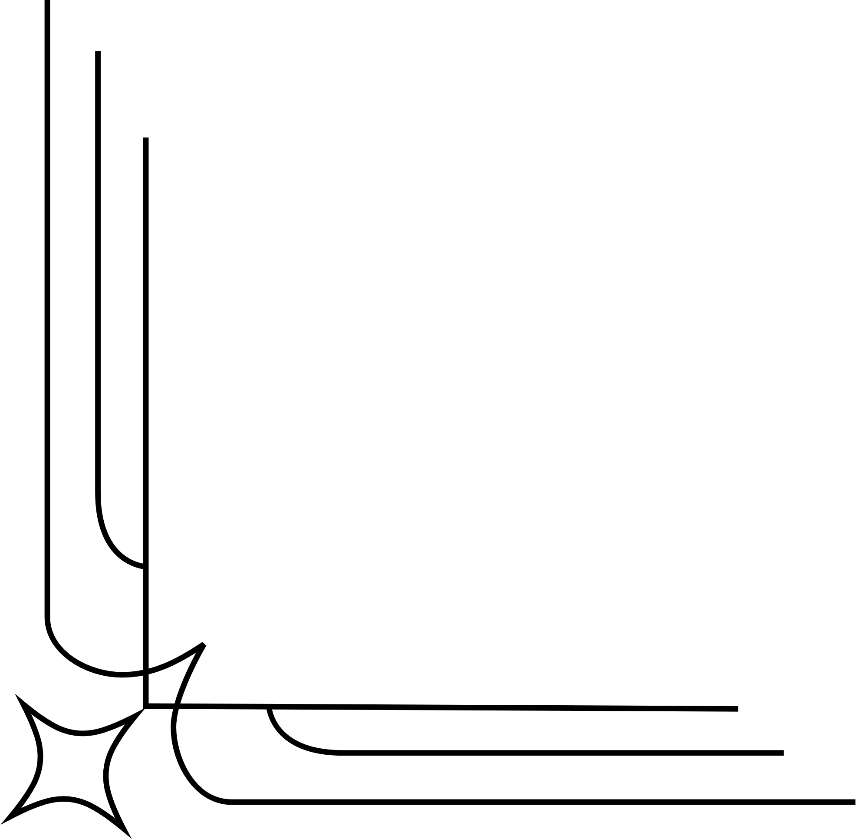
thank you for listening

